Slide 1


Ajay Kumar Garg Engineering College
27th MILE STONE DELHI-HAPUR BYPASS ROAD P.O. ADHYATMIK NAGAR
GHAZIABAD-201009
PROJECT ON :
DYNAMIC WEBSITE
SUBMITTED TO :
MS. SUMITA LAMBA
SUBMITTED BY :
ASHWANI VERMA
BRANCH : CSIT

Slide 2

ABOUT INTERNSHIP TECHNICAL
I PURSUED MY INTERNSHIP FROM UDEMY.
THIS COURSE IS A DEPTH INTRODUCTION TO BOTH FUNDAMENTAL FRONTEND PROGRAMMING CONCEPTS AND THE USES OF HTML , CSS AND JAVASCRIPT PROGRAMMING LANGUAGE.

Slide 3

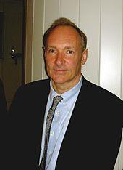
ABOUT HTML
THE HYPERTEXT MARKUP LANGUAGE, OR HTML IS THE STANDARD MARKUP LANGUAGE FOR DOCUMENTS DESIGNED TO BE DISPLAYED IN A WEB BROWSER.
HYPERTEXT REFERS TO LINKS THAT CONNECT WEB PAGES TOGETHER.
HTML IS A MARKUP LANGUAGE THAT WEB BROWSER USE TO INTERPRET AND COMPOSE TEXT, IMAGES, AND OTHER MATERIAL INTO VISUAL OR AUDIBLE WEB PAGES.
IT WAS CREATED BY TIM BERNERS LEE IN 1991.

Slide 4

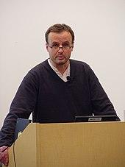
ABOUT CSS
CSS STANDS FOR “CASCADING STYLE SHEETS”.
CSS IS DESIGNED TO ENABLE THE SEPARATION OF PRESENTATION AND CONTENT, INCLUDING LAYOUT COLORS AND FONTS
CSS DESCRIBES HOW HTML ELEMENTS ARE TO BE DISPLAYED ON SCREEN, PAPER, OR IN OTHER MEDIA.
IT WAS DEVELOPED BY Håkon Wium Lie IN 1994.

Slide 5

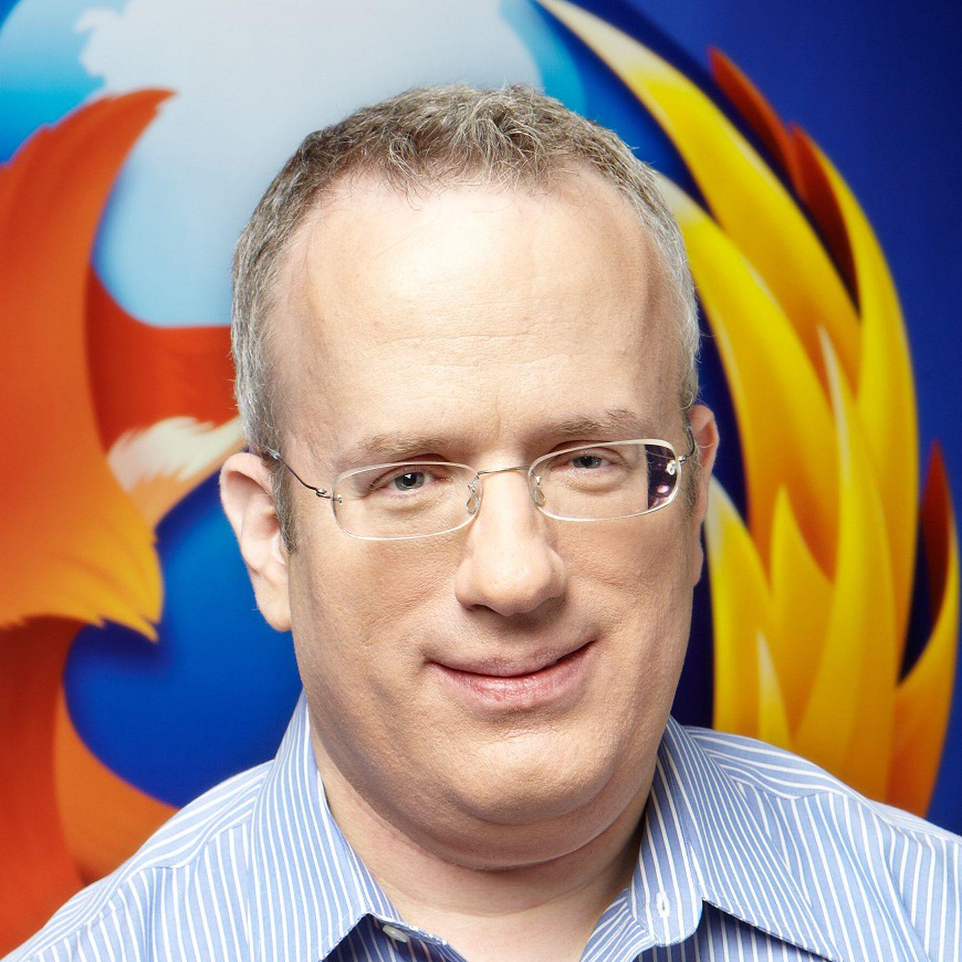
ABOUT JAVASCRIPT
JAVASCRIPT IS A PROGRAMMING LANGUAGE THAT IS ONE OF THE CORE TECHNOLOGIES OF THE WORLD WIDE WEB ALONGSIDE HTML AND CSS.
JAVASCRIPT IS A HIGH-LEVEL OFTEN JUST-IN COMPLETED, MULTI-PARADIGM LANGUAGE.
OVER 97% OF WEBSITES USE JAVASCRIPT ON THE CLIENT SIDE FOR WEB PAGE BEHAVIOR
BRENDAN EICH IS AN AMERICAN COMPUTER PROGRAMMER AND TECHNOLOGY EXECUTIVE. HE CREATED THE JAVASCRIPT PROGRAMMING LANGUAGE

Slide 6
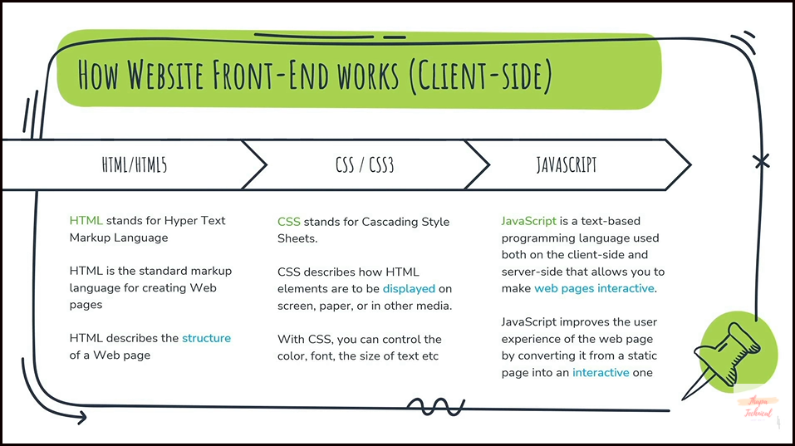
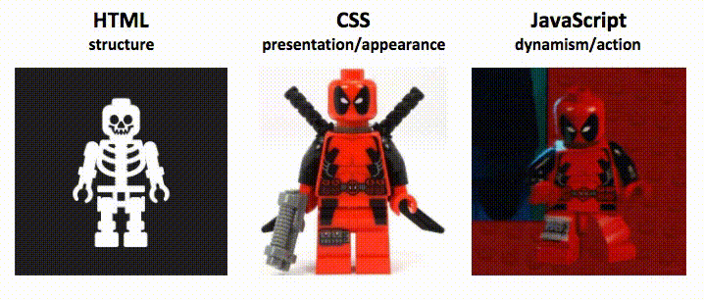
DIFFERENCE BETWEEN THESE THREE

Slide 7
OBJECTIVE
BY THE END OF THE PROJECT, WE WILL BE ABLE TO IDENTIFY THE RISING ACTION, CLIMAX, AND FALLING ACTION ON BIRDS DIVERSITY.
CLIMATE CHANGE IS A GLOBAL PROBLEM AND HENCE IT IS GLOBAL DUTY.
“WE DO NOT INHERIT THE EARTH FROM OUR ANCESTORS; WE BORROW IT FROM OUR CHILDREN”

Slide 8
ABOUT THE PROJECT BIRDS AFFECTION FROM EM RAYS
WE DISCUSS ABOUT THE PROBLEM OF BIRDS DIVERSITY AND THERE DEPLETION BECAUSE OF MOBILE TOWER ELECTROMAGNETIC RADIATIONS.
“THIS IS A BIG, BIG PUNCH IN OUR CONTINENTAL GUT IN TERMS OF WHAT WE’RE DOING TO OUR ENVIRONMENT“
FOR OUR BETTERMENT OF LIVES WE DO NOT DEGRADE FLORA/FAUNA.

Slide 9
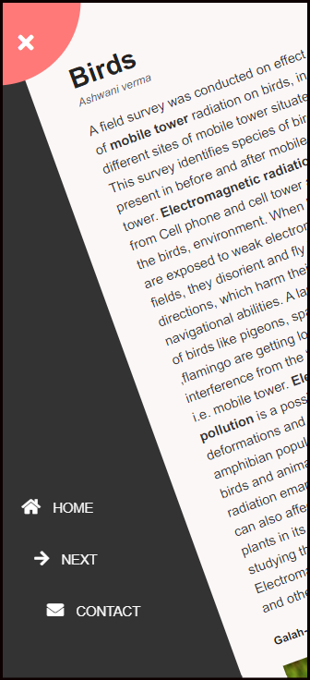
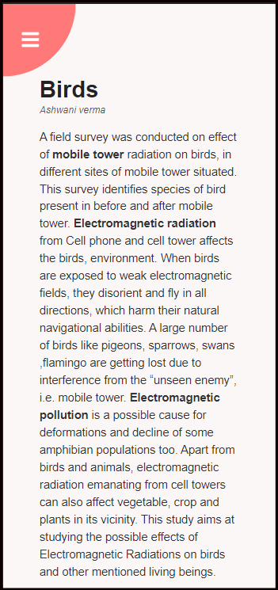
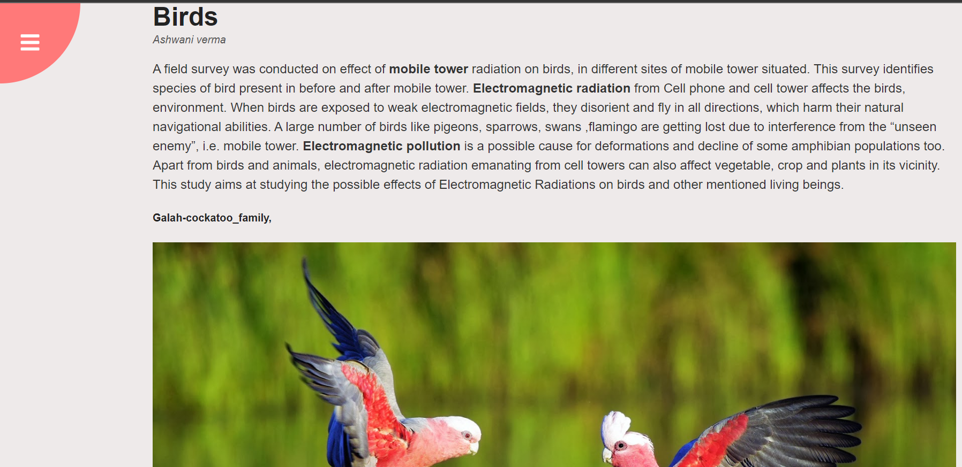
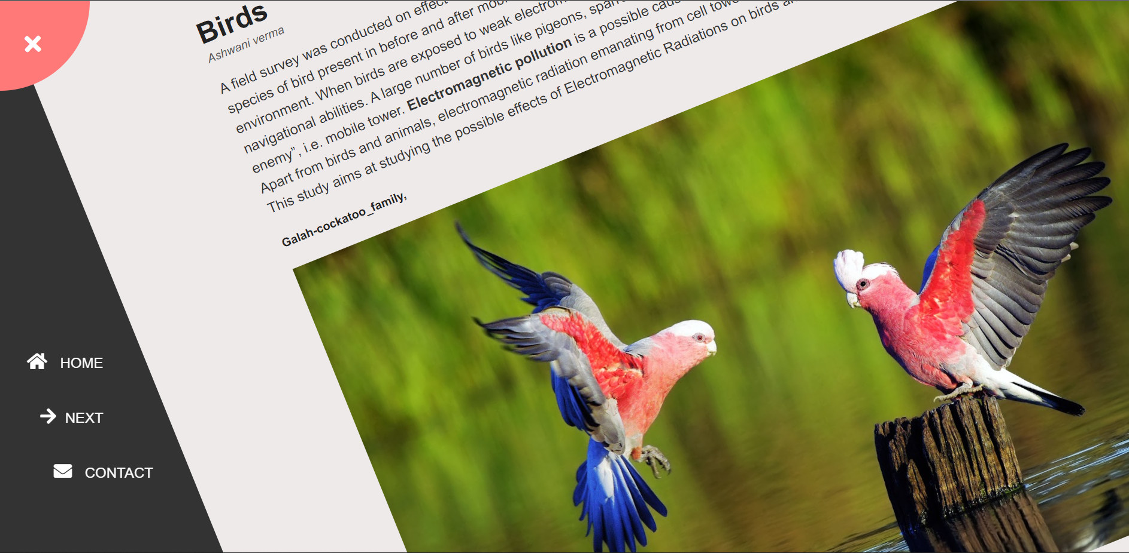
USE COMMAND CALLED TRANSFORM() TO ROTATE THIS CONTAINER
DESKTOP VIEW
MOBILE VIEW

Slide 10
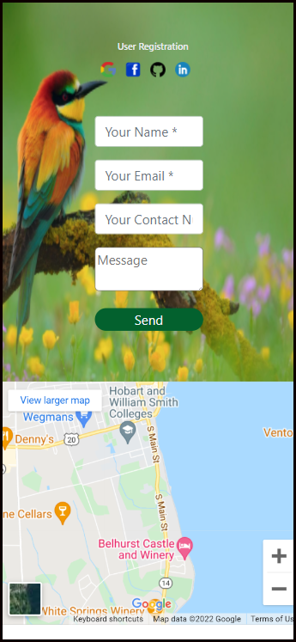
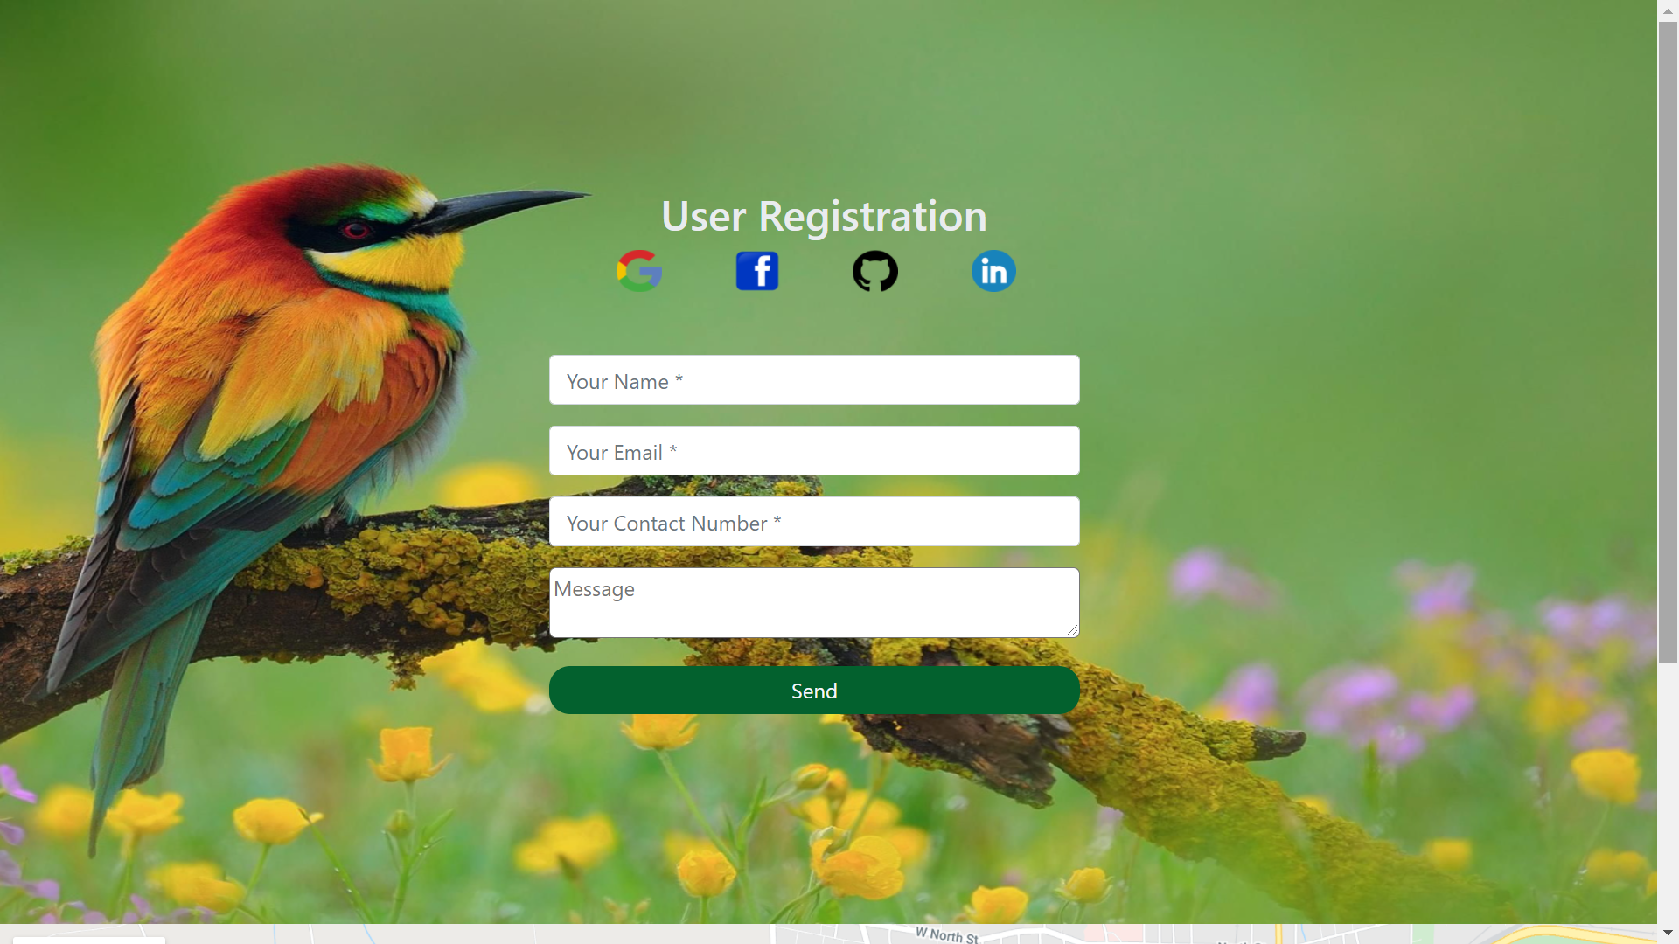
YOU CAN CONTACT THE CONCERN AUTHORITIES FOR
FURTHER QUERY
DESKTOP VIEW
MOBILE VIEW

Slide 11
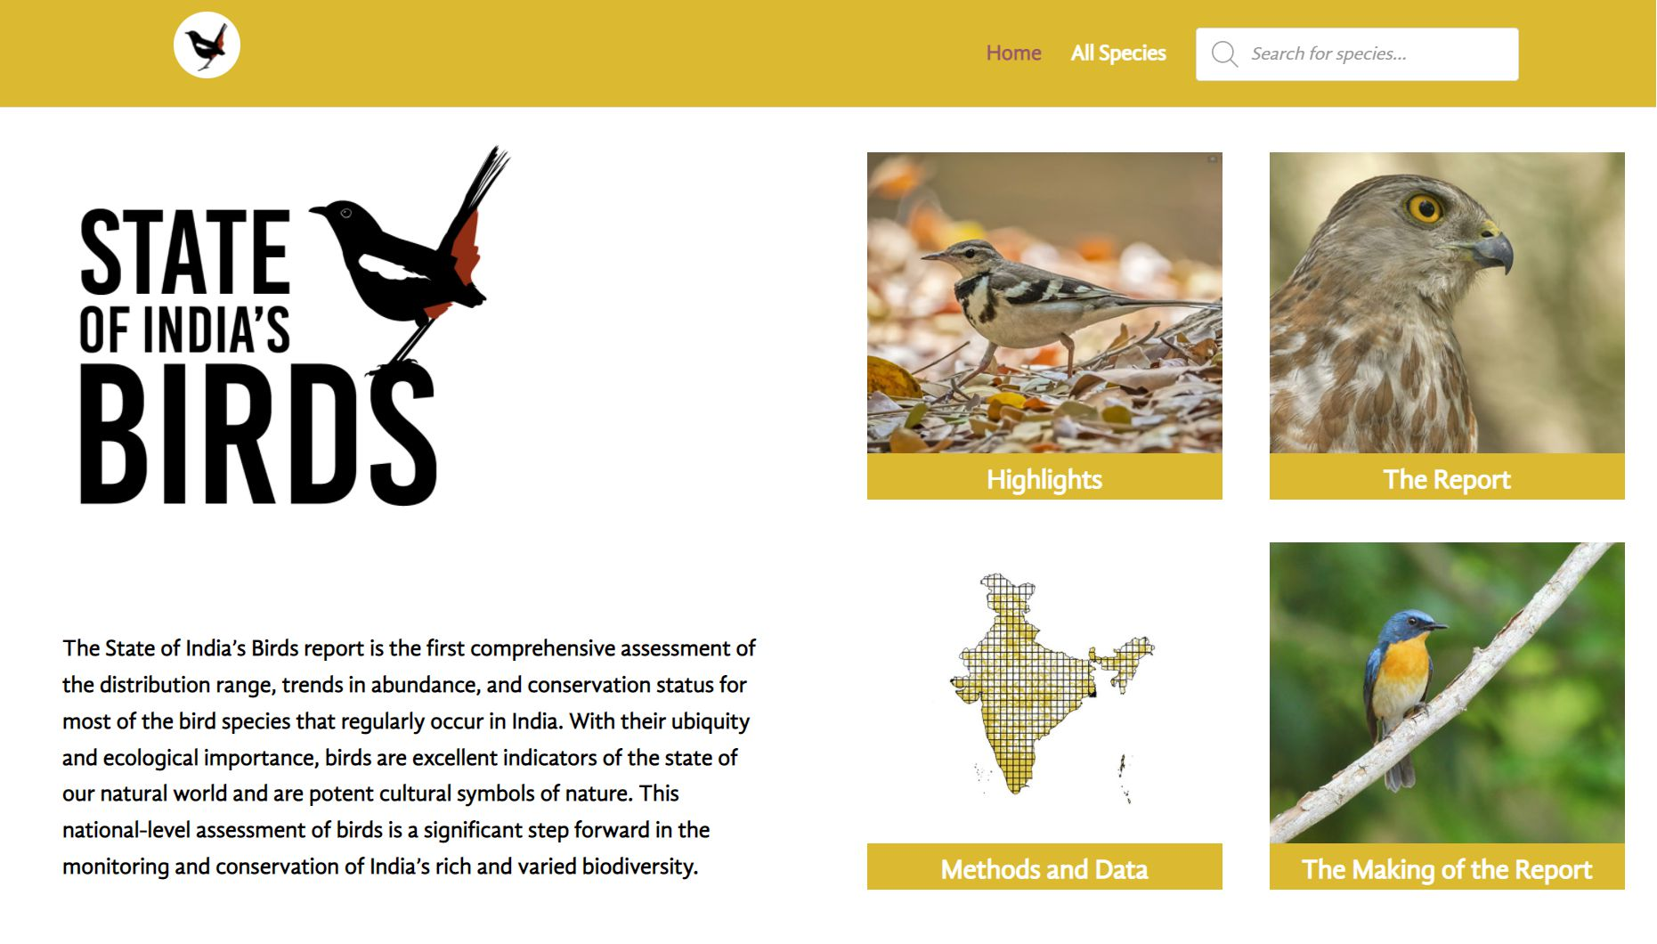
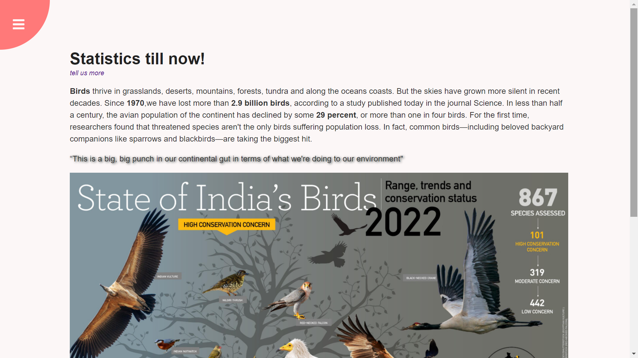
THE DATA HAS BEEN TAKEN FROM OFFICIAL SITE OF STATEOFINDIABIRDS

Slide 12


PUBLISHED ON GITHUB :
CREATED A REPO ON GITHUB FOR BETTOR UNDERSTANDING OF CODE AND WHOLE FUNCTIONING ABOUT PROJECT.
EXPLAIN WHOLE PROJECT ON README VIA PHOTOS, VIDEO AND A LIVE LINK.

Slide 13
CONCLUSION
CELLULAR PHONES ARE ESSENTIAL TO OUR LIVES.
HOWEVER, THEIR EXTENSIVE USAGE AND UPGRADED SERVICES CONTINUE TO THREATEN THE SPECIES DIVERSITY AND THE LIVES OF DIFFERENT BIRDS IN THE REGION.
BIRD DIVERSITY IS IMPORTANT TO KEEP THE PLANT DIVERSITY AND ALL THE RESEARCHERS MUST TRY TO BEGIN LOOKING FOR ALTERNATIVE TECHNOLOGY FOR SAFE SURROUNDINGS.

Slide 14
FUTURE SCOPE
USED AS A ARTICLE TO BE PUBLISH ON GOOGLE.
MAKE A EYE CATCHING INTERACTION WHEN PAGE ROTATES THIS EXCITES USER TO MOVE NEXT.
THIS PROJECT ENABLE USER TO DIRECTLY CONTACT WITH THE CONCERN AUTHORITY,

Slide 15
REFERENCES
www.w3schools.com(https://www.w3schools.com/)
Youtube
Udemy.com/
Google

Slide 16
THANK YOU

